Slide 1
State Diagrams
Discrete Structures (CS 173)
Madhusudan Parthasarathy, University of Illinois

Slide 2
Midterm 3: Dec 3 in class
Skills list on website.
(does not include state-diagrams)
Review problems with solutions.
(more will arrive soon on Moodle)
This week discussion section:
Exam review.
Common mistakes in Midterm 2

Slide 3
Common errors in midterm 2
Problem 3(a): Unrolling functions.
Many students made the mistake of not doing uniform substitution of n, in the expansion of f(n).
For example, if f(n) = 2f(n-1)+n^2 and we want to expand f(n-1) further,
f(n) = 2 f(n-1) +n^2 = 2[ 2f(n-1) + (n-1)^2] + n^2
Note that in the expansion of f(n-1), we get (n-1)^2, not n^2.
This is a common mistake.

Slide 4
Common errors in midterm 2
Problem 3(b): Proving 1-1 ness
Many students argue in words why the function is 1-1.
That’s just not acceptable… you need to give a formal proof.
Many students try to prove 1-1 by showing that if (x1,y1) \not = (x2, y2), then f(x1,y1)\not=f(x2,y2). But this is typically harder to show.
It’s easier to show the contrapositive: If f(x1,y1) = f(x2,y2), then x1=x2 and y1=y2.

Slide 5
Common errors in midterm 2
Problem 5:
Some students miss the case where two minimal graphs each can be l-colored , but the constructed graph still needs 2-colors..
Some people only prove very specific cases! (like when the graphs are cycles!), and do not pure the general case.
Lots of points will be deducted for such answers (more advanced courses can give 0—so it’s good to stop this habit).
Some people had no explanation as to why their answer was correct (i.e., why the chromatic number of the combined graph is what they claimed).
In fact, to show the chromatic number is something, you need to prove that it is an upper bound *and* a
lower bound.

Slide 6
Common errors in midterm 2
Problem 6:
1. Base case error. As the problem is given by recursive definition, the base case should be F0,F1. Some students skip these two and take F2 as base case. Very few students give F1 and F2 as base cases.
2. IH error.
In the IH part, one typical error is supposing for all n>=2 the claim hold, which directly covers all cases.
Also, most of the students didn't give the range for k (which the book is missing too). I write that on most of their papers.
3. Missing edge cases: most common error is missing some edge cases, e.g.,: a) In IH assume from 0 to k-1, but in IS try to prove F(k+1), which leaves F(k) not proved;
b) In IH assume from 0 to k, k>=2, in IS try to prove F(k+1), which leaves F(2) not proved

Slide 7
State diagrams
Model set of valid actions and their effect on “world” state
Nodes represent states
Edges indicate that it is possible to transition from one state to another
Labels on edges indicate how to transition
Many applications
Simple electronics
Games, e.g., AI controls
Probabilities over multiple turns
Probabilistic inference for multiple variables (e.g., handwriting recognition)
Planning in robotics

Slide 8
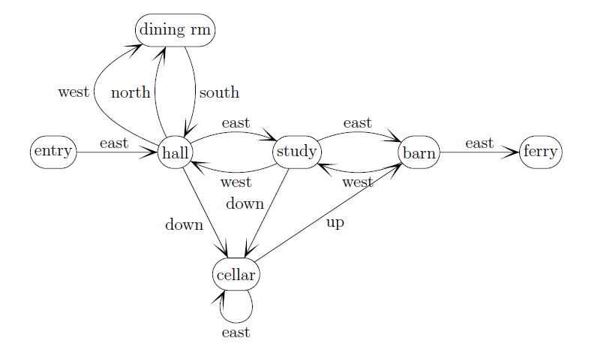
State diagrams
state
transition
action
Transition function:
$$\left(dining rm, south\right)→hall$$

Slide 9
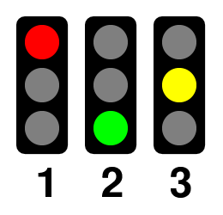
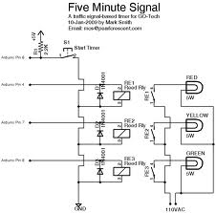
Simple example: traffic signal

Slide 10
Transition functions and state diagrams
States: Village, Rock, Snake, Chasm, Gold, Desert
Transitions:
(Village, North) → Desert
(Village, East) → Snake
(Desert, South) → Village
(Desert, East) → Rock
(Rock, West) → Desert
(Snake, West)→Village
(Snake, East) → Chasm
(Snake, South) → Gold
(Gold, North)→Snake

Slide 11
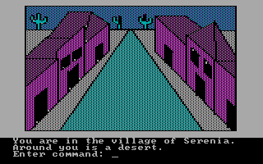
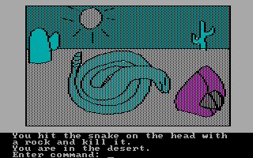
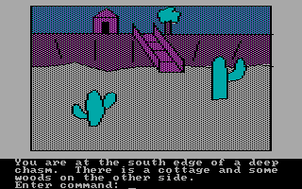
Transition functions and state diagrams
Input sequence to beat the game: N, E, E, E, E, N, E, N, W, GET ROCK, N, W, N, W, N, W, N, THROW ROCK, N, DRINK WATER, E, GET STICK, THROW STICK, W, N, THROW STICK, LOOK HOLE, GET NOTE, N, W, LIFT ROCK, N, GET NOTE, E, GET LOCKET, E, E, S, W, W, LOOK HOLE, GET CRACKER, E, N, N, W, N, W, N, SAY HOCUS, N, GO HOUSE, GET APPLE, W, N, LOOK GNOME, N, E, SAY HISS, GO CREVICE, S, S, S, GET BREAD, GET LOCKET, GET CRACKER, UNLOCK DOOR, OPEN DOOR, GO DOOR, U, GO HOLE, N, E, S, GIVE CRACKER, GET VIAL, N, W, S, W, W, THROW BREAD, N, GET ROPE, GO BOAT USE BLANKET, N, N, DRINK WATER, N, E, E, E, GO BEACH, N, N, E, GET ANCHOR, W, TIE ROPE, TO ANCHOR, THROW ANCHOR, UP, GET SHOVEL, DOWN, S, S, DIG X, LOOK TREASURE, GRAB CHEST, LEAVE, E, N, W, GO CAVE, OPEN CHEST, LOOK CHEST, GET HARP, N, E, N, DRINK VIAL, FLY NORTH, N, GET RING, N, W, FOLLOW RAINBOW, GET COIN, N, SAY LUCY, W, W, N, GO CAVE, GET ALL, N, S, W, PLAY HARP, N, N, BUY HORN, N, N, BLOW HORN, N, U, E, OPEN CLOSET, LOOK CLOSET, GET SHOES, LOOK SHOES, W, D, W, W, LOOK THRONE, THROW APPLE, N, E, LOOK CABINET, PICK LOCK, WITH KNIFE, OPEN DOOR, E, U, D, U, WEAR RING, RUB RING, D, E, KISS FROG, WEAR SHOES, SAY WHOOSH
Adventures in Serenia

Slide 12
Making a NAND diagram

Slide 13
Frogger
Strategy to cross road

